Slide 1
Community: The Secret Ingredient for DevOps
Nathen Harvey

Slide 2
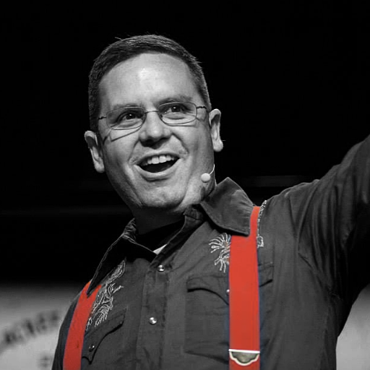

Nathen Harvey
VP, Community Development at Chef
Co-host of the Food Fight Show Podcast
Occasional farmer – http://ei.chef.io
Love eggs – http://eggs.chef.io
#hugops – http://hugops.chef.io
@nathenharvey
nharvey@chef.io

Slide 3
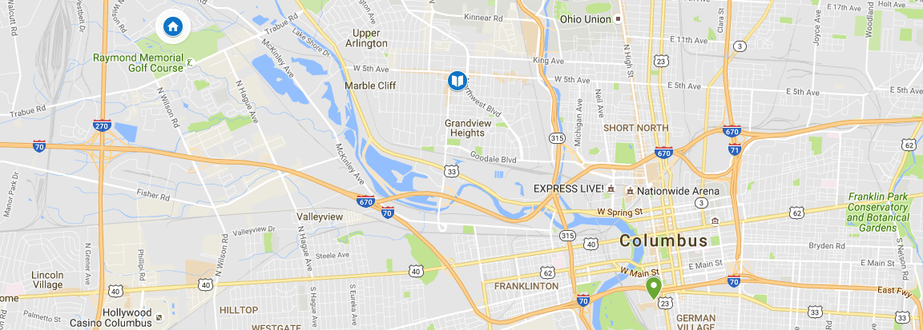
My Columbus Community
Notes:
30 years ago, I lived in Columbus.

Slide 4
My Columbus Community
DevOpsDays

Slide 5
My Columbus Community
Elementary School
DevOpsDays

Slide 6
My Columbus Community
Elementary School
Home
DevOpsDays
Notes:
I left Columbus in 1987.

Slide 7
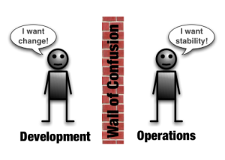
Wall of Confusion
http://dev2ops.org/2010/02/what-is-devops/

Slide 8

FORM DIVERSE BONDS

Slide 9
FORM DIVERSE BONDS
Take people to lunch, or have meetings, with people outside your specialty

Slide 10
FORM DIVERSE BONDS
Take people to lunch, or have meetings, with people outside your specialty
Ask them what they do, and try and understand their problems and perspective

Slide 11
FORM DIVERSE BONDS
Take people to lunch, or have meetings, with people outside your specialty
Ask them what they do, and try and understand their problems and perspective
Legal, Finance, Sales, Marketing, Business Development, Software Development, Systems Administrators, Security Professionals, Product

Slide 12
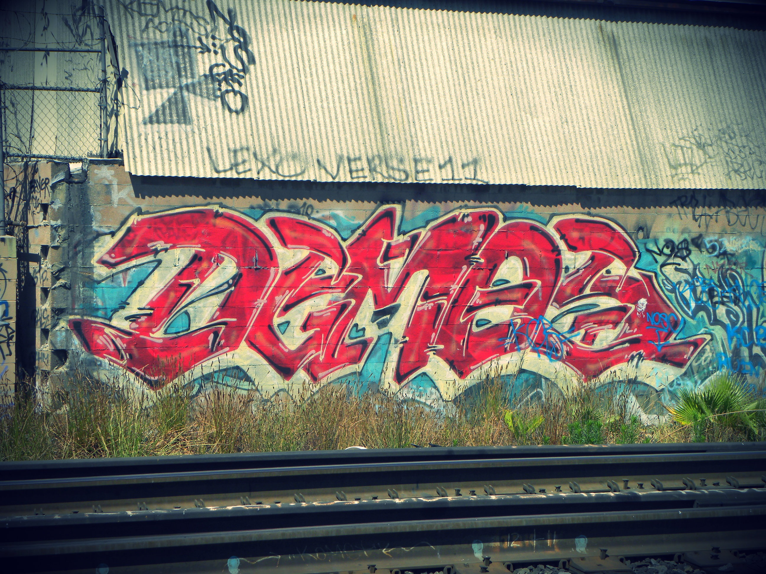
Demo Days!

Slide 13
Demo Days!
Weekly

Slide 14
Demo Days!
Weekly
Anyone with anything to show

Slide 15
Demo Days!
Weekly
Anyone with anything to show
Invite everyone

Slide 16
Demo Days!
Weekly
Anyone with anything to show
Invite everyone
Record it and post it internally

Slide 17
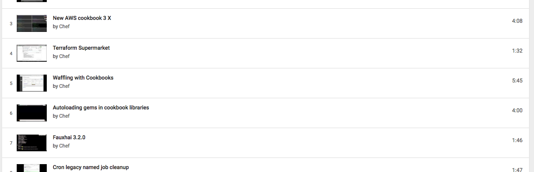
Chef Demo Days Playlist on YouTube
https://goo.gl/UEfyKl

Slide 18
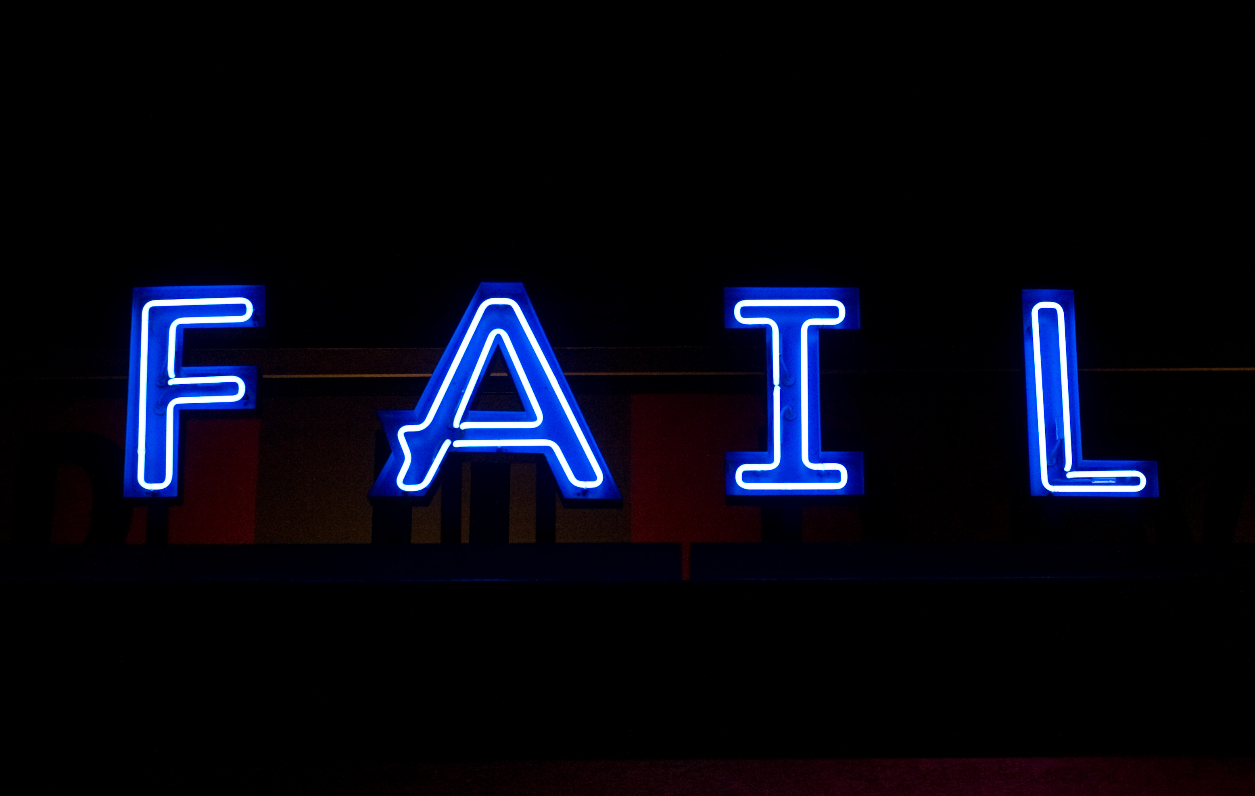

Slide 19
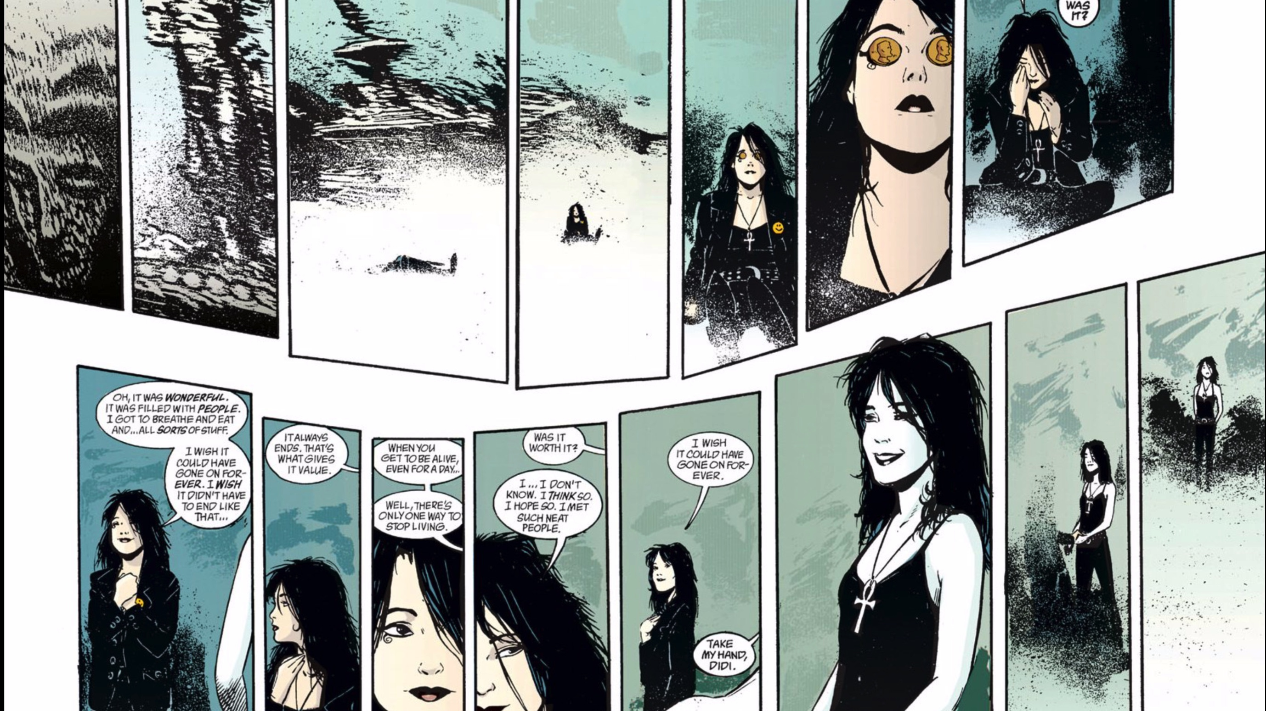
Post Mortems
Invoke the space: here to learn, not blame
Describe the incident
Establish the timeline
Identify contributing factors
Describe customer impact
Describe remediation tasks
Describe improvement tasks

Slide 20

Post Mortems
Time to Detect
Time to Resolve

Slide 21
Post Mortems – Who Attends?
Required
Incident commander
People actively involved in incident response
Representative from each team likely to receive action items
Invited
Engineering, Operations, and everything in-between
The entire company
Notes:
How does this build “community”

Slide 22
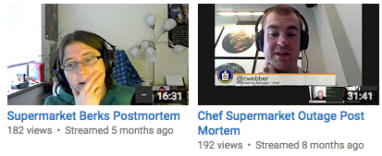
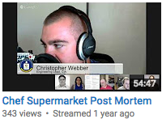
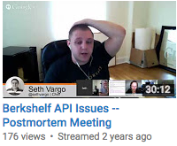
Post Mortems – Who Attends?
Required
Incident commander
People actively involved in incident response
Representative from each team likely to receive action items
Invited
Engineering, Operations, and everything in-between
The entire company
The public
Notes:
Speaking of “The public”….let’s take a look at how you can start to expand beyond your company’s four walls and participate in the larger DevOps Community.

Slide 23

Slack - https://goo.gl/LqYhEA

Slide 24
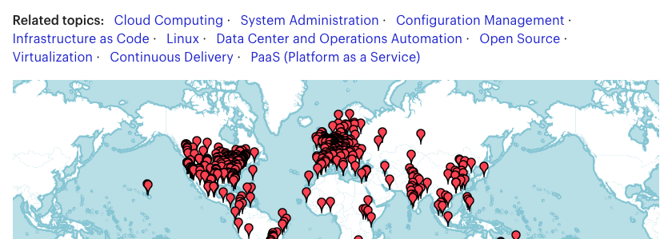
Meetups
Notes:
Listen, learn, present, interact
Hire or be hired
Form bonds, get to know people.

Slide 25
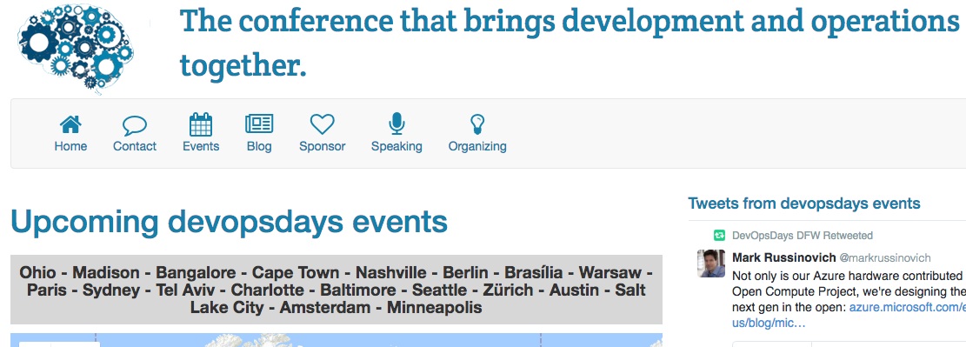
Conferences

Slide 26
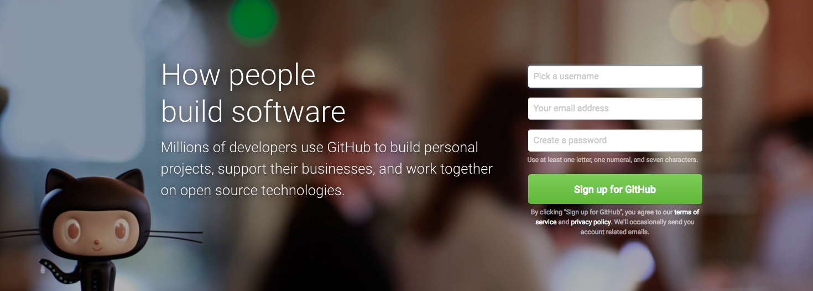
Open Source
Notes:
Types of contributions

Slide 27
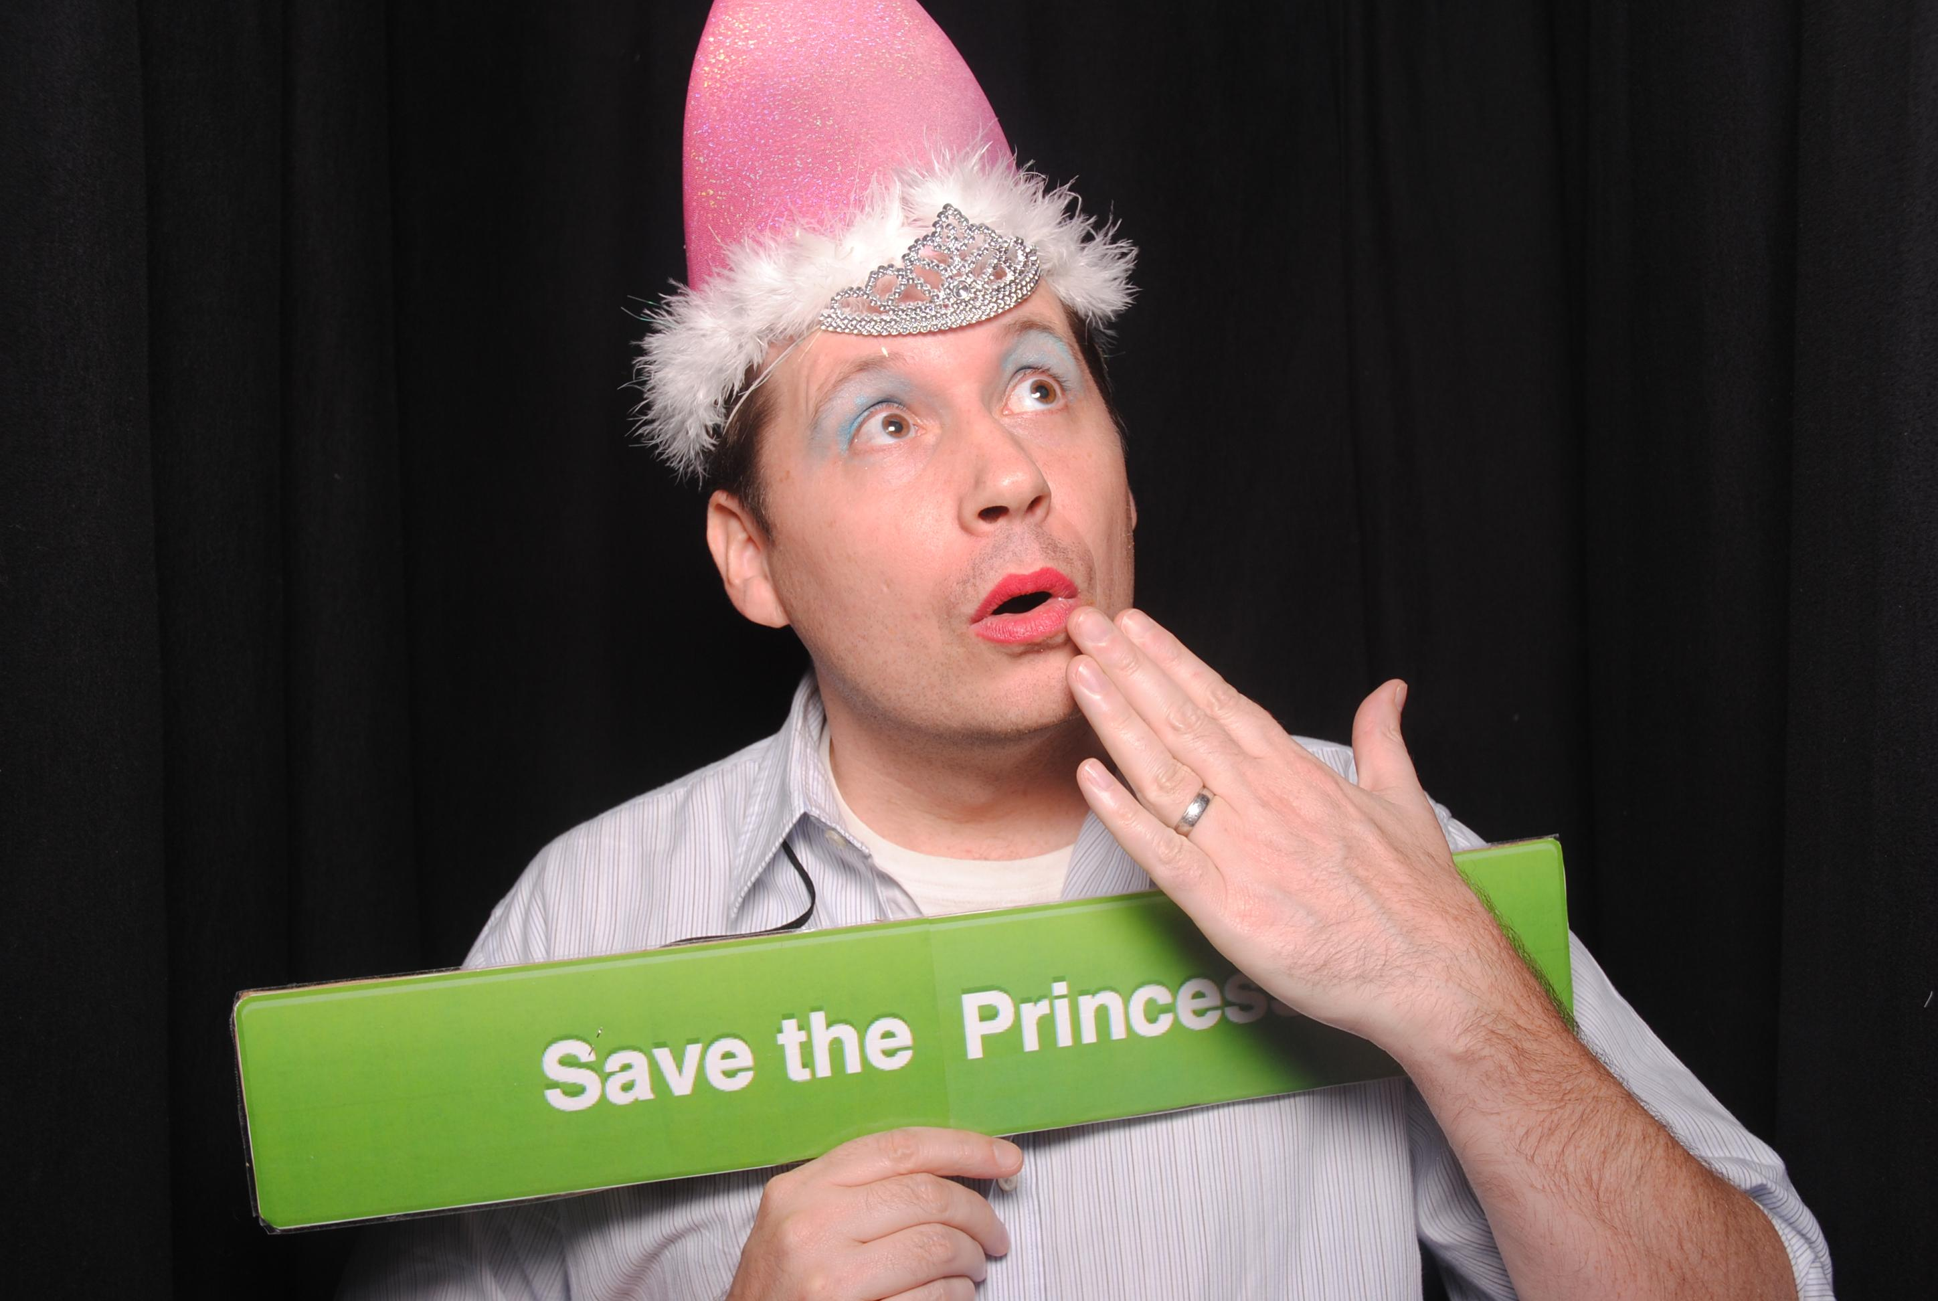
DEVOPS
A cultural and professional movement, focused on how we build and operate high velocity organizations, born from the experiences of its practitioners.

Slide 28
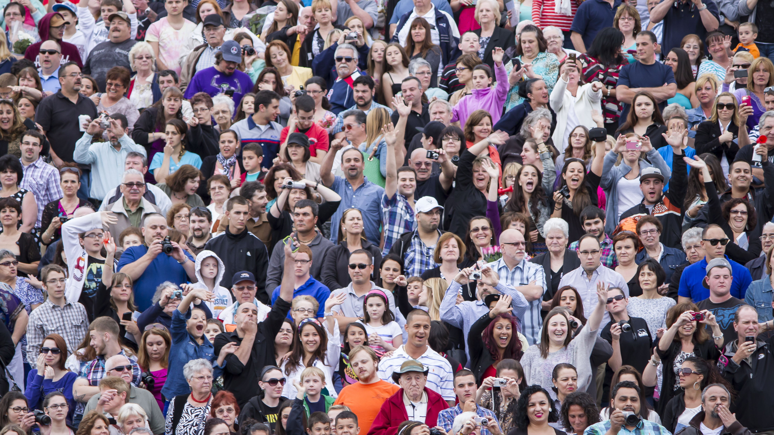
People
Products
Companies
Notes:
What we've learned
Fast, efficient, software driven
Happy people...
In that order

Slide 29

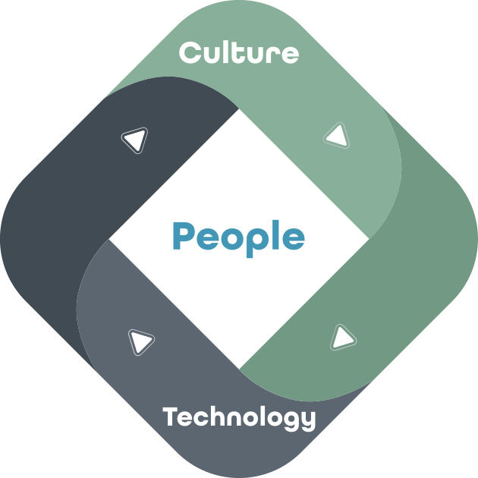
Notes:
Happy people
Culture + Technology
Virtuous Cycle
Example is workflow
https://flic.kr/p/rcEUS

Slide 30
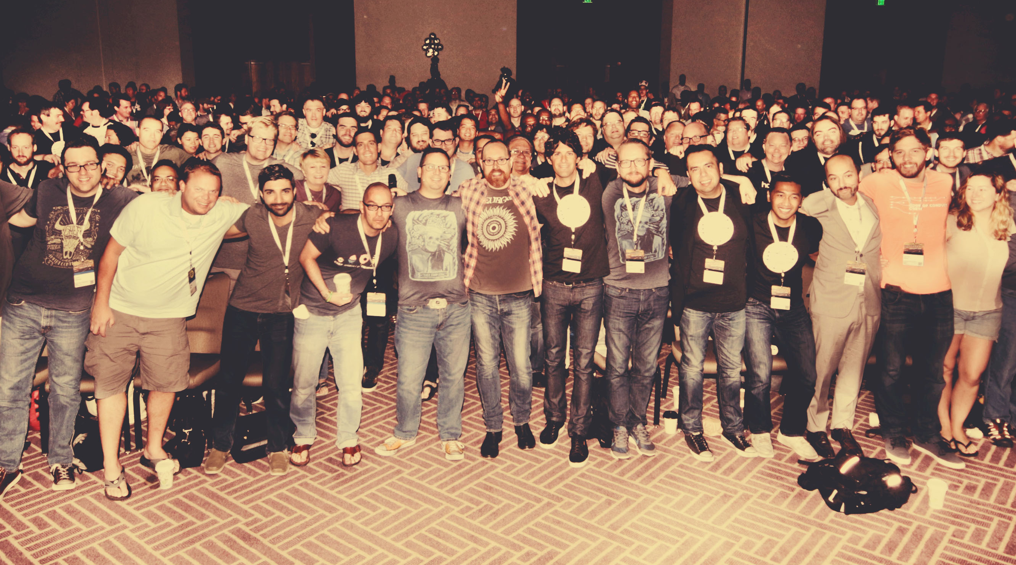
Non-bullet slide
Non-bullet slide subtitle
Community
Our Foundation

Slide 31
Building a DevOps Community
Internal
Form diverse bonds
Demo Days
Post Mortems
External
Online community
Meetups and Conferences
Open Source

Slide 32
You are responsible…
For your learning
For your development
For your career
For your teammates
For lots of important things

Slide 33
…but you are not alone!
Find a mentor
Lean on your peers
Mentor someone
Give back

Slide 34
Nathen Harvey
VP, Community Development at Chef
Co-host of the Food Fight Show Podcast
Occasional farmer – http://ei.chef.io
Love eggs – http://eggs.chef.io
#hugops – http://hugops.chef.io
@nathenharvey
nharvey@chef.io

